Slide 1
Marker module Identification and subgroup inference of single-cell RNA-seq data by nearest neighbor searching
Zhixin Li
July 13, 2018
Notes:
Module-based

Slide 2
Clustering and the role of marker
Heterogeneity
developmental/pathogenic mechanism
Before scRNA-seq:
Morphology
Surface protein
Marker gene: uniquely/highly expressed gene for certain cells.
Cell identity: marker can reliably distinguish between two or more clusters.
The main purpose of clustering is to find subtypes and corresponding markers.
Crucially, marker genes can be used for experimental validation.
Notes:
Why sc is so important, because it can help us to reveal the Heterogeneity of our cells
The changes of the Heterogeneity can help us to study the –
People use – to distinguish different cells

Slide 3
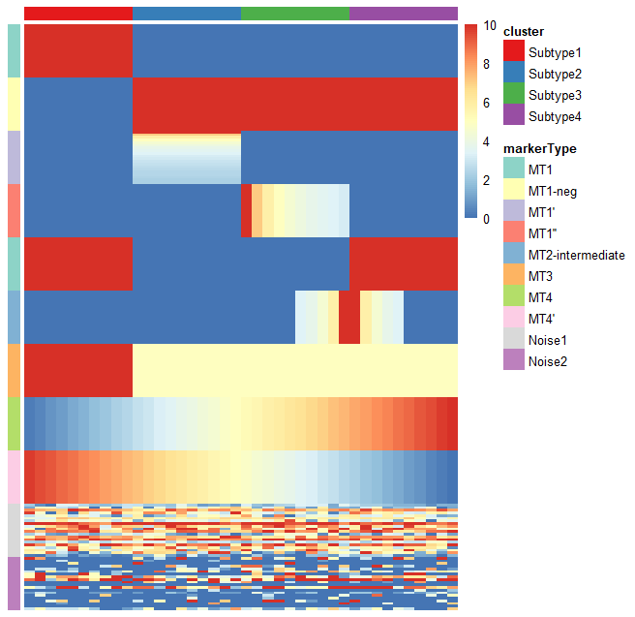
Simulated dataset
A subtype can be defined by a few robust markers (marker module) .
The more markers, the stronger the reliability of the subtype.
Marker types (MTs)
MT1 – uniquely expressed genes with the same expression level
MT1-neg – negative markers of MT1
MT1’ – uniquely expressed genes with different expression levels
MT1’’ – uniquely expressed genes which change across cells
MT2-intermediate – intermediate genes between two subtypes
MT3 – highly expressed genes in certain subtypes
MT4 – genes with gradually rising/falling expression
Noise – randomly expressed genes
Genes
Cells
Notes:
In order to show different marker types, I made this simulated dataset
Zero inflated distributions

Slide 4
Current clustering method and their limitations
SC3 (Kiselev et al., Nature Methods 2017) is based on PCA and spectral dimensionality reductions.
SIMLR (Wang et al., Nature Methods 2017) is a kernel-based similarity learning method.
Seurat (Butler et al., Nature Biotechnology 2018) is a community detection approach similar to SNN-Cliq
t-SNE + k-means (10x Genomics official method)
SINCERA (Guo et al., 2015) is based on hierarchical clustering
pcaReduce (žurauskienė and Yau, 2016) combines PCA, k-means and “iterative” hierarchical clustering.
SNN-Cliq (C. Xu and Su, 2015) is a graph-based method.
Find the relationship (e.g. distance) between cells based on all the features (gene)
Limitations:
Inevitably need to choose a k for clustering (subjectivity)
feature selection is crucial
Some confounding genes (cell cycle, apoptosis) may largely affect the clustering
Risk of overfitting, because of p >> n (p denotes feature count, n denotes sample size)
Computationally expensive, especially for large dataset (>1000 cells)
Notes:
But ttey all have sth in common, they all try to –
These methods have some obvious limitations,
far greater than
For clustering this means the clusters you are finding only exist in your dataset and can't be seen in new data.
Your algorithm might find two clusters in the dataset that don't exist for new data, because both clusters are actually subset of one bigger cluster. Your algorithm is overfitting, your clustering is too fine (e.g. your k is too small for k-means) because you are finding groupings that are only noise.

Slide 5
More background

Slide 6
Inspiration
Correlation between the genes in the same marker module is significantly higher.
Can we identify all the marker modules first and then using them to do the clustering?
Notes:
The inspiration of this method is –

Slide 7
10% dropout rate
Marker modules still can be captured
by correlation relationship.
Dropout events: high chance of missing nonzero entries as zero, due to the technical and biological noise.
(low number of RNA transcriptomes and the stochastic nature of the gene expression pattern)
Notes:
Here, I add 10% - to the simulated dataset
Dropout event is the most significant catachrestic for scRNA-seq
Wrong, the markers have high correlation with each other is a marker module.
Some markers may merge together

Slide 8
3% dropout rate
Marker modules still can be captured
by correlation relationship.
Dropout events: high chance of missing nonzero entries as zero, due to the technical and biological noise.
(low number of RNA transcriptomes and the stochastic nature of the gene expression pattern)
Notes:
Here, I add 10% - to the simulated dataset
Dropout event is the most significant catachrestic for scRNA-seq
Wrong, the markers have high correlation with each other is a marker module.
Some markers may merge together

Slide 9
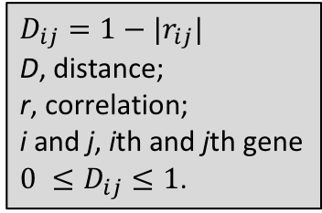
Algorithm overview
$$D_{ij}=1−|r_{ij}|$$
D, distance;
r, correlation;
i and j, ith and jth gene
$0 ≤D_{ij}≤1$.
A robust subtype of cells can be defined by a few (5-10) core markers.
Core markers locate in the local centers (gene clusters with high density) in the gene-gene distance network.
Core markers identification is a question of local center identification.
“Slicing and scanning” method can effectively detect the local center of a network.
KNN can be used for full marker module identification.
Subtypes can be inferred by the core markers .
Noise gene
Marker module2
Marker module1
Marker module3
Rare marker module
Local center
Gene-gene distance network
Notes:
For the convenience of calculation
How to show gene-gene network, hclust
Or show pca plot of genes

Slide 10
MSIC overview
Cell outlier detection
Build gene-gene correlation network
Identify local centers of the network
Define and classify the marker modules
Infer the subtypes by marker modules
Identify full marker modules by nearest searching

Slide 11
subtype2
outlier
outlier
outlier
Main part
subtype1
Rare subgroup
subtype3
Classical version: observations lying “far away” from the main part of a dataset and probably not following the assumed model (Becker and Gather, 1999).
Single cell version: cells far away from any subgroups in a heterogeneous cell population.
Purpose: removing the extreme outliers far away from any cells and keep the rare cell populations.
Notes:
Correlation is the basic for further analysis.
Correlation, especially Pearson correlation, is very sensitive to strong outliers.
Make a cartoon plot to show the difference.
Why need dimension reduction?
Why current method can not be used?
How my method can detect if there is a outlier?

Slide 12
Quantify the effect of outlier
Public dataset:
Pollen et al.,2014, NBT
Cells: 249
Genes: 6982
Ground-truth:
Clusters
Markers and non-markers
Conclusion: extreme outliers will seriously affect the correlation between markers.
Notes:
I did a test, I added some outliers into the test dataset, check if it will affect the correlation between the true markers.
Show the necessary for outlier detection
Quantify the effect of outlier
Few outlier will not affect the correlation
Show why spearman is better than pearson

Slide 13
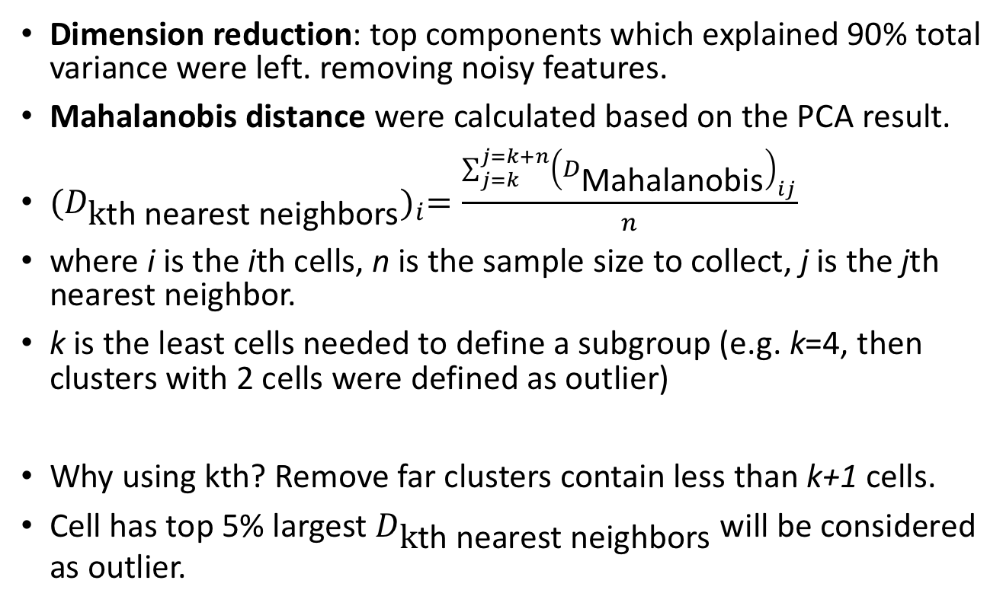
Outlier detection algorithm
Dimension reduction: top components which explained 90% total variance were left. removing noisy features.
Mahalanobis distance were calculated based on the PCA result.
${(D_{\text{k}\text{th} \text{nearest} \text{neighbor}\text{s}})}_{i}=\frac{\sum_{j=k}^{j=k+n}{{\left(D_{\text{Mahalanobis}}\right)}_{ij}}}{n}$
where i is the ith cells, n is the sample size to collect, j is the jth nearest neighbor.
k is the least cells needed to define a subgroup (e.g. k=4, then clusters with 2 cells were defined as outlier)
Why using kth? Remove far clusters contain less than k+1 cells.
Cell has top 5% largest $D_{\text{k}\text{th} \text{nearest} \text{neighbor}\text{s}}$ will be considered as outlier.
K=4, n=3
Notes:
For each cell, I will calculate the kth -.
This method can keep rare cell populations after removing outlier.
why removing outlier is necessary? using simulated data to explain this point
why current outlier detection method is not suitable? use ground truth to demonstrate this point, compare different tools (removing the rare populations)
why using dimension reduction (cite paper)? top 100 or 95% explained variance PCs
try different dimension reduction method (PCA and DM), compare the results
outlier detection algorithm, minNum

Slide 14
Performance (2 dimensions)
Public dataset:
Deng et al.,2014, Science
Cells: 268
Genes: 22431
Ground-truth:
Clusters
Markers and non-markers
cluster1
cluster2
cluster3
our tool: k=4, n=5
Compare to mvoutlier
Simulation: only 1, 2 and 4 cells were retained for cluster1, cluster2 and cluster3 to simulate some outliers.
Our method can accurately identify the outliers (cluster1 and cluster2) and keep the rare cluster3.
mvoutlier failed to detected the simulated outliers.
Notes:
I did a test

Slide 15
Definition
What is core marker? Indeed, in a clustering heatmap, there are core markers can represent all the markers and can define the subgroups.
What is local center? High density center of a cluster
How to identify all the local center? It depends on the threshold! Manually is ok, but how to make it automatically and robustly?
This method can’t avoid the defect of correlation. It contains all the defect of correlation.

Slide 16
Foreach local center, get nearest top 100 gene;
If

Slide 17
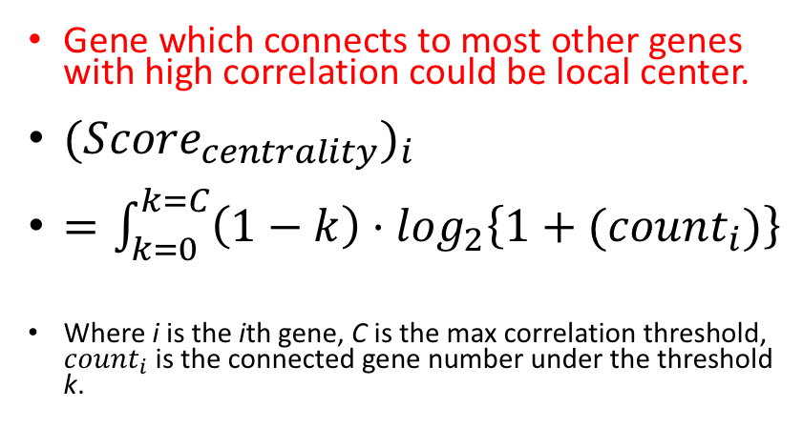
“Slicing and scanning”
 | 0.05 | 0.1 | 0.15 | 0.2 | 0.25 | 0.3 | 0.35 | 0.4 | 0.45 | 0.5 | 0.55 | 0.6 | 0.65 | centrality
CLDN6 | 0 | 0 | 5 | 16 | 33 | 63 | 91 | 136 | 200 | 278 | 393 | 549 | 786 | 23.12
CLDN7 | 0 | 0 | 5 | 18 | 30 | 54 | 85 | 134 | 196 | 268 | 376 | 551 | 770 | 22.99
KRT18 | 0 | 0 | 3 | 14 | 34 | 53 | 90 | 125 | 183 | 266 | 379 | 543 | 767 | 22.85
CLDN4 | 0 | 0 | 2 | 16 | 28 | 52 | 88 | 129 | 192 | 265 | 373 | 530 | 750 | 22.77
ANXA3 | 0 | 0 | 1 | 12 | 30 | 57 | 96 | 129 | 187 | 274 | 381 | 531 | 761 | 22.76
EPCAM | 0 | 0 | 2 | 15 | 29 | 49 | 81 | 127 | 184 | 258 | 372 | 519 | 744 | 22.66
ARHGAP29 | 0 | 0 | 2 | 13 | 27 | 52 | 85 | 124 | 177 | 262 | 370 | 520 | 729 | 22.62
KRT19 | 0 | 0 | 1 | 10 | 26 | 53 | 84 | 125 | 179 | 261 | 371 | 553 | 776 | 22.59
KRT8 | 0 | 0 | 2 | 9 | 29 | 47 | 80 | 118 | 176 | 252 | 363 | 535 | 755 | 22.50
TACSTD2 | 0 | 0 | 1 | 8 | 23 | 49 | 79 | 118 | 177 | 250 | 362 | 503 | 718 | 22.30
SPINT2 | 0 | 0 | 0 | 6 | 26 | 48 | 80 | 115 | 176 | 251 | 362 | 525 | 745 | 22.21
WNT6 | 0 | 0 | 0 | 4 | 23 | 45 | 78 | 114 | 172 | 243 | 364 | 515 | 737 | 22.05
ACSM3 | 0 | 0 | 0 | 4 | 17 | 40 | 72 | 115 | 161 | 238 | 340 | 483 | 695 | 21.76
CDH6 | 0 | 0 | 0 | 3 | 19 | 45 | 75 | 111 | 162 | 234 | 331 | 479 | 691 | 21.75
ANXA2 | 0 | 0 | 0 | 8 | 14 | 37 | 58 | 100 | 148 | 221 | 319 | 482 | 677 | 21.55
CDH1 | 0 | 0 | 0 | 3 | 18 | 37 | 64 | 98 | 156 | 221 | 324 | 471 | 687 | 21.50
PLP1 | 0 | 0 | 0 | 1 | 10 | 33 | 69 | 102 | 153 | 234 | 353 | 515 | 727 | 21.39
EFNA1 | 0 | 0 | 0 | 2 | 16 | 35 | 65 | 93 | 150 | 223 | 322 | 467 | 671 | 21.35
SEMA3D | 0 | 0 | 0 | 2 | 18 | 37 | 64 | 102 | 144 | 225 | 309 | 447 | 646 | 21.34
VAMP8 | 0 | 0 | 0 | 2 | 17 | 34 | 63 | 100 | 144 | 215 | 316 | 459 | 671 | 21.32
CD24 | 0 | 0 | 0 | 4 | 14 | 33 | 62 | 103 | 148 | 212 | 307 | 454 | 622 | 21.30
DMKN | 0 | 0 | 0 | 1 | 11 | 32 | 67 | 101 | 148 | 211 | 331 | 482 | 700 | 21.23
CYP26A1 | 0 | 0 | 0 | 2 | 11 | 31 | 58 | 95 | 146 | 213 | 304 | 433 | 631 | 21.04
MYL12B | 0 | 0 | 0 | 2 | 11 | 28 | 59 | 96 | 144 | 213 | 301 | 436 | 646 | 21.03
PDLIM1 | 0 | 0 | 0 | 1 | 14 | 31 | 59 | 95 | 143 | 213 | 304 | 427 | 633 | 21.01
TSTD1 | 0 | 0 | 0 | 0 | 12 | 34 | 66 | 94 | 144 | 207 | 304 | 454 | 641 | 20.93
LY6E | 0 | 0 | 0 | 3 | 10 | 30 | 51 | 89 | 137 | 203 | 291 | 416 | 603 | 20.87
TINAGL1 | 0 | 0 | 0 | 0 | 12 | 31 | 55 | 95 | 136 | 205 | 291 | 426 | 622 | 20.73
PERP | 0 | 0 | 0 | 0 | 9 | 27 | 58 | 82 | 135 | 198 | 291 | 458 | 654 | 20.64
RPS2 | 0 | 0 | 1 | 7 | 13 | 35 | 54 | 68 | 108 | 161 | 242 | 328 | 510 | 20.56
TDRP | 0 | 0 | 0 | 0 | 8 | 29 | 50 | 90 | 132 | 202 | 281 | 417 | 619 | 20.51
SLC2A3 | 0 | 0 | 0 | 2 | 5 | 24 | 48 | 87 | 129 | 183 | 287 | 411 | 590 | 20.46
RPS3 | 0 | 0 | 1 | 6 | 14 | 36 | 57 | 73 | 101 | 152 | 215 | 305 | 473 | 20.39
EDNRB | 0 | 0 | 0 | 1 | 3 | 20 | 50 | 84 | 122 | 183 | 293 | 438 | 656 | 20.32
ATP1B3 | 0 | 0 | 0 | 0 | 1 | 25 | 51 | 91 | 139 | 201 | 300 | 463 | 675 | 20.28
SEMA3A | 0 | 0 | 0 | 0 | 4 | 22 | 44 | 74 | 121 | 185 | 285 | 424 | 621 | 20.10
SPP1 | 0 | 0 | 0 | 0 | 3 | 20 | 45 | 86 | 121 | 178 | 273 | 425 | 624 | 20.05
KRT7 | 0 | 0 | 0 | 0 | 6 | 20 | 42 | 68 | 117 | 179 | 257 | 391 | 609 | 19.96
TPM1 | 0 | 0 | 0 | 0 | 4 | 25 | 44 | 75 | 116 | 175 | 251 | 393 | 557 | 19.91
PTN | 0 | 0 | 0 | 0 | 2 | 16 | 43 | 78 | 116 | 176 | 265 | 408 | 606 | 19.77
Gene which connects to most other genes with high correlation could be local center.
${({Score}_{centrality})}_{i}$
$=\int_{k=0}^{k=C}{\left(1−k\right)·\log_{2}\left\{1+({count}_{i})\right\}}$
Where i is the ith gene, C is the max correlation threshold, ${count}_{i}$ is the connected gene number under the threshold k.
The area
Notes:
Find the area of this shadow
Integral
No overlap, so you can get the right area
积分写错了

Slide 18
Nearest neighbors searching (core markers)
Local center
Step1: define the local centers, initialize the marker module
Step2: Iteratively find the nearest neighbor of the marker module
Step3: update the marker module
Step4: until the new nearest neighbor far away from half of the genes (or center) in the marker module under a certain threshold
Noise gene
Marker module
Gene-gene distance network
Notes:
['itə,reitivli]

Slide 19
Full marker module identification (KNN)
A new gene is classified by a majority vote of its neighbors, with the gene being assigned to the marker module most common among its k nearest neighbors.
K was chosen by cross validation.
Kd tree was used to improve the searching efficiency.
Noise gene
Marker module2
Marker module1
Marker module3

Slide 20
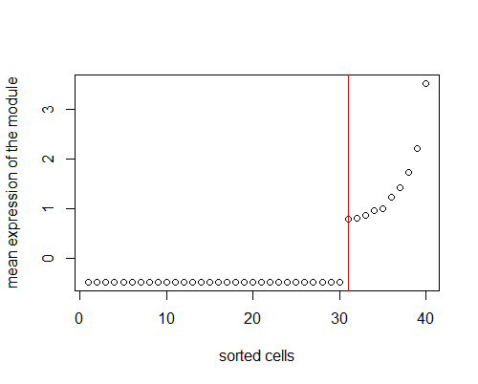
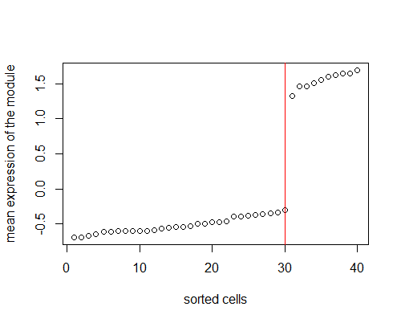
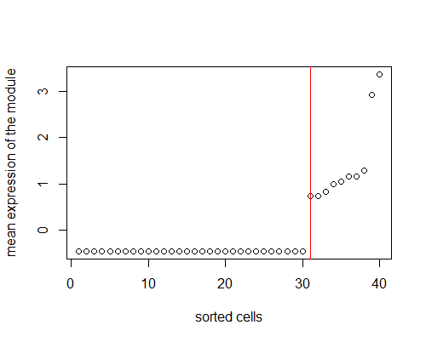
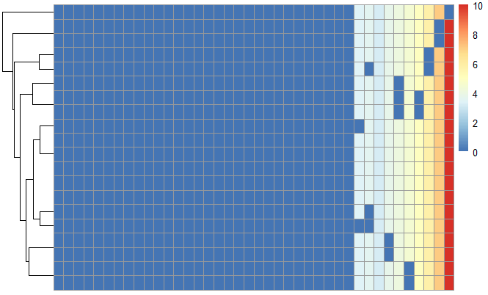
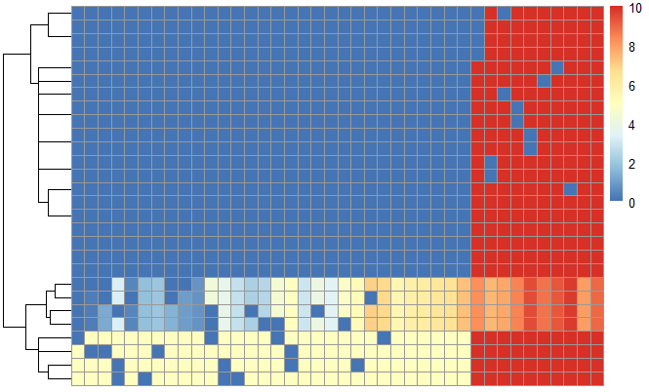
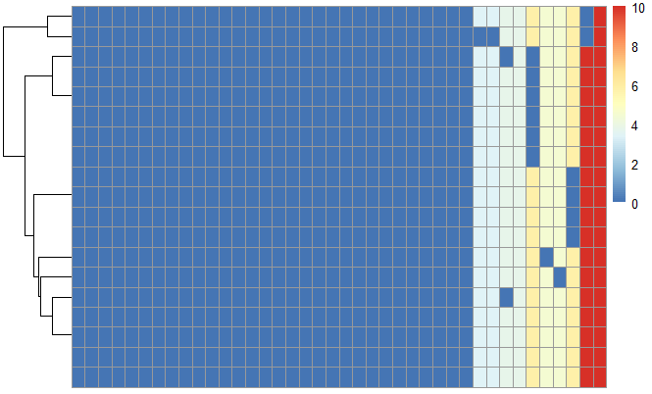
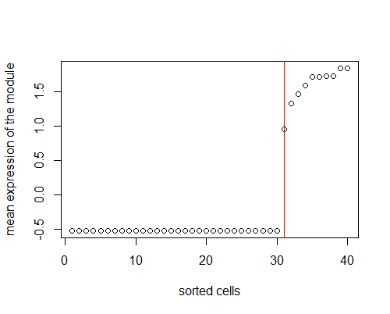
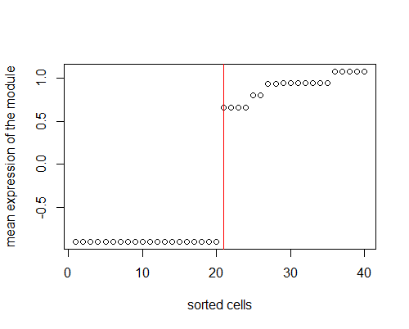
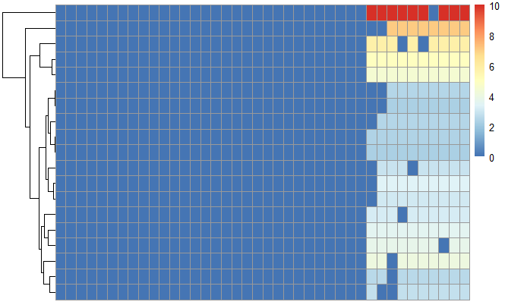
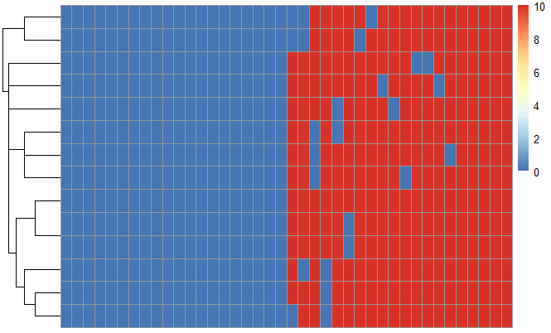
Performance on simulated dataset
breakpoint
Marker module
High
correlation
Notes:
Our tool can identify five marker modules in –
For a marker module, and each cells, I will calculate the mean expression of the genes, using some statistical method, the breakpoint here can be inferred.
Subtypes inference
To compare two sets of clustering labels we can use adjusted Rand index. The index is a measure of the similarity between two data clusterings. Values of the adjusted Rand index lie in [0,1] interval, where 1 means that two clusterings are identical and 0 means the level of similarity expected by chance.

Slide 21
Performance on real dataset
Smart-seq(2)
Expensive
100-1000 cells
3k-10k expressed genes
Low dropout rate
10x genomics
Relative cheap
1k-10k cells
500-3000 expressed genes
High dropout rate
estimate the dropout rate
Notes:
There are two mainstream platforms

Slide 22
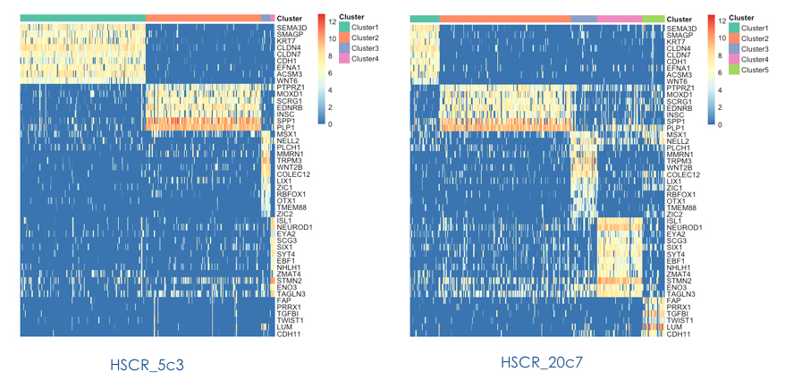
Smart-seq dataset (our HSCR cells)
Ground truth
cluster1
cluster2
cluster3
New module
All marker modules in ground truth can be detected by MSIC.
Three new modules are detected.
cluster5
New module
New module

Slide 24
HSCR_5c3
Performance of MSIC on HSCR_5c3.
All previous four clusters can be identified.
A new intermediate cluster (cluster4) was identified.
GO and KEGG annotations were done based on the five gene lists (top 100 for each cluster).

Slide 25
cluster1
GO
KEGG

Slide 26
cluster2
GO
KEGG
No result

Slide 27
cluster3
GO
KEGG

Slide 28
cluster4
GO
KEGG

Slide 29
cluster5
GO
KEGG
No result

Slide 30
Co-expression network analysis
MSIC is Similar to WGCNA in some part.
WGCNA
No outlier detection
Hierarchical clustering (poor for core marker identification)
Only for full module identification
Cannot be used in scRNA-seq
MSIC can also be used for bulk RNA-seq samples anaylsis (>100)
Notes:
[haɪə'rɑːkɪk(ə)l]

Slide 31
Execution time comparison
Genes: 30,000
Time/min | 400 cells | 1200 cells | 2000 cells | 3000 cells | 4000 cells
MSIC | ~5 | ~10 | - | - | -
SC3 | ~10 | ~120 | - | - | -
SIMLR | 1.66 | 20.40 | - | - | -
Seurat | - | - | - | - | -
…
Low algorithm complexity
The most time consuming step is correlation calculation.
More tools and datasets will be tested in the future.

Slide 32
Advantages of this method
No need to choose a k for clustering
No need to do feature selection
Can identify negative markers, intermediate subgroup and rare subgroup
Greatly reduce the computing resource
Great benefit for downstream analysis (pathway)

Slide 33
Discussion
Dropout rate may largely affect the result with the increasing of total cells.
Notes:
Core markers (5-10) are enough for subtype inference.
Full markers are good for pathway analysis.

Slide 34
After WGCNA
Now, module detection is not a problem.
Problem is how many modules should be kept for cluster inference!
K-means is enough to divide cells to two clusters based on a module.
Final clusters
Most modules are meaning full.

Slide 35
New concepts
Is the power β useful?
Adjacency matrix
Connectivity (also known as degree)
Intramodular connectivity, module membership (wheel plot)
Module eigengene E & intramodular hub gene
Eigengene significance
Gene significance GS
Module significance
Marker identification (traits) (biomarkers or therapeutic targets)

Slide 36
1. network construction;
2. module detection;
3. module and gene selection;
4. calculations of topological properties;
5. data simulation;
6. visualization;
7. interfacing with external software packages.

Slide 37
How to calculate p-value for correlation?
Firstly, should I use a power β during the network construction?
Should I judge if the network is a scale-free network?
pickSoftThreshold,
pickHardThreshold
scaleFreePlot
Notes:
https://support.minitab.com/en-us/minitab-express/1/help-and-how-to/modeling-statistics/regression/how-to/correlation/methods-and-formulas/

Slide 38
topological overlap measure
clustering dendrogram
network heatmap plot (interconnectivity plot)
multi-dimensional scaling plot (standard R function cmdscale)
cluster stability/robustness analysis
Summarizing the profiles of a module, moduleEigengenes
module membership (wheel plot)
block-wise module detection?
Notes:
https://labs.genetics.ucla.edu/horvath/MTOM/

Slide 39
gene significance measure as a function GS
trait-based gene significance measure as the absolute correlation between the trait and the expression profiles
mean gene significance across modules
Scatterplot of gene significance (y-axis) vs. module membership (x-axis) in the most significant module
Hierarchical clustering dendrogram of module eigengenes
Heatmap plot of the adjacencies in the eigengene network including the trait y

Slide 40
Visualization
Log-log plot of whole-network connectivity distribution
classical multidimensional scaling
Network heatmap plot (TOM plot)
Gene significance across modules
GS vs. MM, green module
Module eigengene dendrogram
Eigengene network heatmap

Slide 41
Mathematical language
cluster stability/ robustness analysis

Slide 42
Shift genes
Genes shift from one cluster/module to another cluster/module
Biological meaning

Slide 43
To do
Write a paper
Write a R package (submit to Bioconductor)

Slide 44
deng
pollen

